Slide 1
Stack & Queue
Notes:
https://www.w3resource.com/c-programming-exercises/linked_list/index.php
http://www.ggu.ac.in/download/IT/Inf%20Tech%20Pankaj%20Chandra%20B%20Tech%20%20IV%20Data%20Structure%20-%20Model%20Answer.pdf

Slide 2
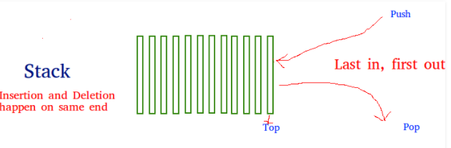
Stack Data Structure
Stack is a linear data structure which follows a particular order in which the operations are performed. The order may be LIFO(Last In First Out) or FILO(First In Last Out).
Mainly the following basic operations are performed in the stack:
Push: Adds an item in the stack. If the stack is full, then it is said to be an Overflow condition.
Pop: Removes an item from the stack. The items are popped in the reversed order in which they are pushed. If the stack is empty, then it is said to be an Underflow condition.
Peek or Top: Returns top element of stack.
isEmpty: Returns true if stack is empty, else false.
Isfull: Returns true if stack is full, else false.

Slide 3
Stack Data Structure
How to understand a stack practically? There are many real life examples of stack. Consider the simple example of plates stacked over one another in canteen. The plate which is at the top is the first one to be removed, i.e. the plate which has been placed at the bottom most position remains in the stack for the longest period of time. So, it can be simply seen to follow LIFO/FILO order.
Time Complexities of operations on stack:
push(), pop(), isEmpty() and peek() all take O(1) time. We do not run any loop in any of these operations.

Slide 4
Stack Data Structure
Real life examples of stack are:
To reverse a word. You push a given word to stack - letter by letter - and then pop letters from the stack.
An "undo" mechanism in text editors; this operation is accomplished by keeping all text changes in a stack.
Undo/Redo stacks in Excel or Word.
Language processing :
space for parameters and local variables is created internally using a stack.
compiler's syntax check for matching braces is implemented by using stack.
A stack of plates/books in a cupboard.
Wearing/Removing Bangles.
Support for recursion
Activation records of method calls.

Slide 5
Push Operation
The push operation is used to insert an element in to the stack.
The new element is added at the topmost position of the stack.
First check if TOP==MAX-1. If true, then it means the stack is full and no more insertions can further be added, an OVERFLOW message is printed.
If not true, increase TOP by 1, then add the element at TOP position
A | B | C | D | E
0 1 2 3 TOP = 4 5 6 7 8 9
A | B | C | D | E | F
0 1 2 3 4 TOP =5 6 7 8 9

Slide 6
Pop Operation
The pop operation is used to delete the topmost element from the stack.
First check if TOP == -1. If true then it means the stack is empty so no more deletions can further be done, an UNDERFLOW message is printed. If not true, get the value of the top element, decrease TOP by one.
A | B | C | D | E
0 1 2 3 TOP = 4 5 6 7 8 9
A | B | C | D
0 1 2 TOP = 3 4 5 6 7 8 9

Slide 7
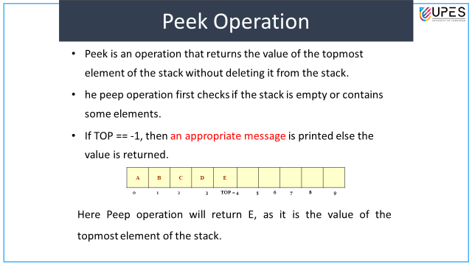

Slide 8
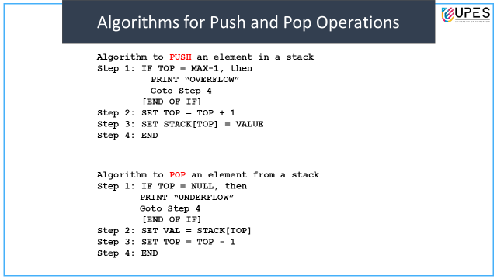

Slide 9
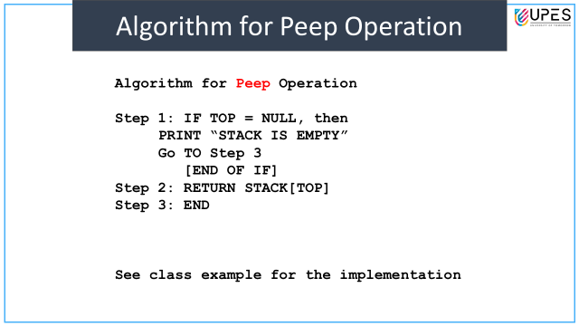

Slide 10
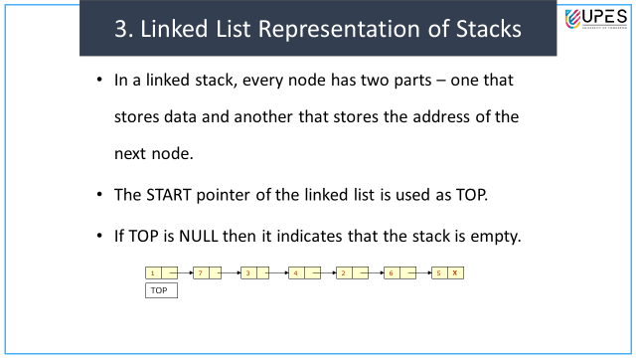

Slide 11
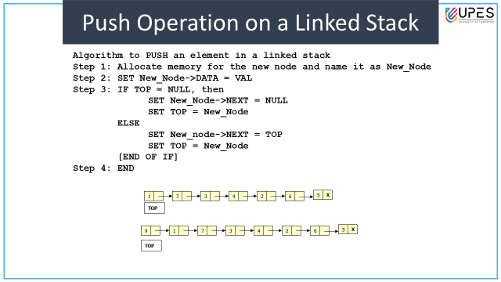

Slide 12
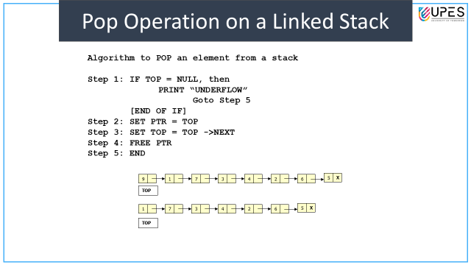

Slide 13
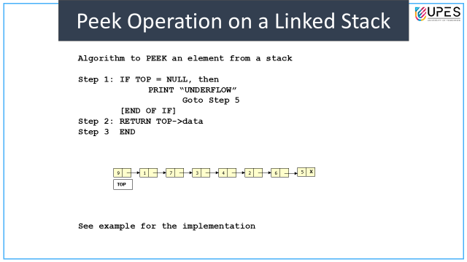

Slide 14
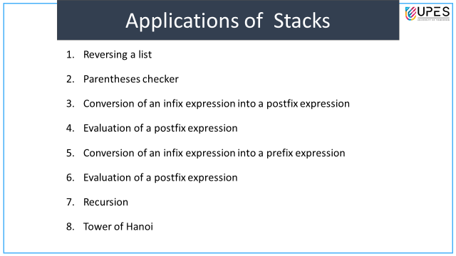

Slide 15
Stack implementation using Array
Refer Program here

Slide 16
Stack implementation using linked list
Stack is an area of memory that holds all local variables and parameters used by any function, and remembers the order in which functions are called so that function returns occur correctly.
Each time a function is called, its local variables and parameters are “pushed onto” the stack. When the function returns these locals and parameters are “popped.” Because of this, the size of a program’s stack fluctuates constantly as the program is running, but it has some maximum size.
A list with the restriction that insertion and deletion can be performed only from one end.
stack is as a last in, first out (LIFO) abstract data type and linear data structure.
Linked list is a data structure consisting of a group of nodes which together represent a sequence.
Here we need to apply the application of linked list to perform basic operations of stack.
Refer Program here

Slide 17
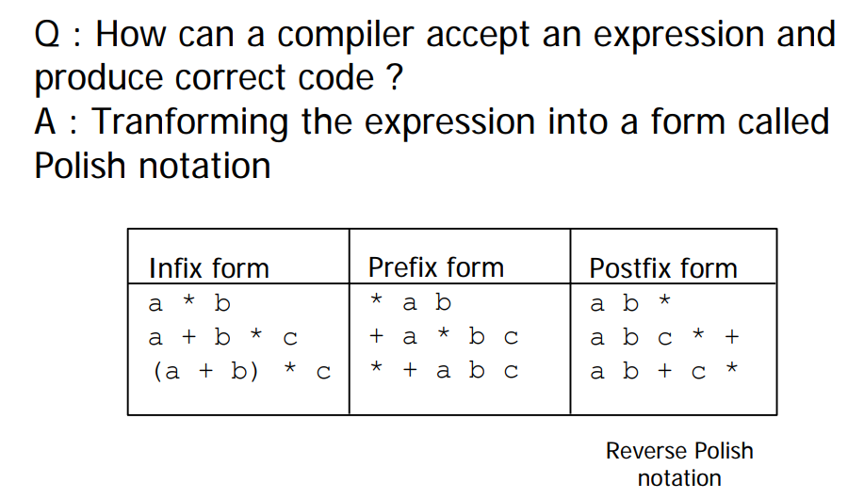
The Polish Notation

Slide 18
Infix Notation
To add A, B, we write
A+B
To multiply A, B, we write
A*B
The operators ('+' and '*') go in between the operands ('A' and 'B')
This is "Infix" notation.

Slide 19
Prefix Notation
Instead of saying "A plus B", we could say "add A,B " and write
+ A B
"Multiply A,B" would be written
* A B
This is Prefix notation.

Slide 20
Postfix Notation
Another alternative is to put the operators after the operands as in
A B +
and
A B *
This is Postfix notation.
Notes:
"A,B are multiplied"
"A,B are added"

Slide 21
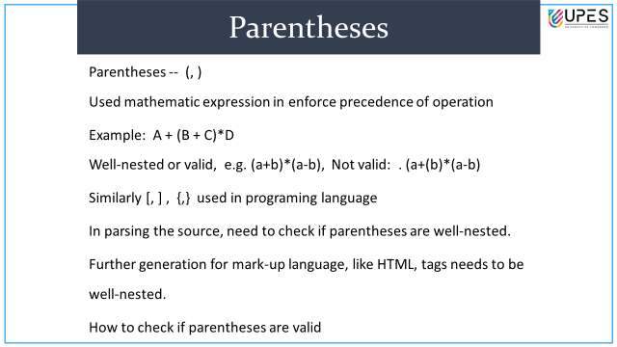

Slide 22
Parentheses
Evaluate 2+3*5.
+ First:
(2+3)*5 = 5*5 = 25
* First:
2+(3*5) = 2+15 = 17
Infix notation requires Parentheses.

Slide 23
What about Prefix Notation?
+ 2 * 3 5 =
= + 2 * 3 5
= + 2 15 = 17
* + 2 3 5 =
= * + 2 3 5
= * 5 5 = 25
No parentheses needed!

Slide 24
Postfix Notation
2 3 5 * + =
= 2 3 5 * +
= 2 15 + = 17
2 3 + 5 * =
= 2 3 + 5 *
= 5 5 * = 25
No parentheses needed here either!

Slide 25
Conclusion:
Infix is the only notation that requires parentheses in order to change the order in which the operations are done.

Slide 26
Fully Parenthesized Expression
A fully parenthesized infix arithmetic expression is an infix arithmetic expression where every operator and its arguments are contained in parentheses.
Which is fully parenthesized?
( A + B ) * C
( ( A + B) * C )
( ( A + B) * ( C ) )
(2+3)
(1+((2+3)∗(4∗5)))

Slide 27
Infix Notation
Infix, Postfix and Prefix notations are three different but equivalent notations of writing algebraic expressions.
While writing an arithmetic expression using infix notation, the operator is placed between the operands. For example, A+B; here, plus operator is placed between the two operands A and B.
Although it is easy to write expressions using infix notation, computers find it difficult to parse as they need a lot of information to evaluate the expression.
Information is needed about operator precedence, associativity rules, and brackets which overrides these rules.
So, computers work more efficiently with expressions written using prefix and postfix notations.

Slide 28
Postfix Notation
Postfix notation was given by Jan Łukasiewicz who was a Polish logician, mathematician, and philosopher. His aim was to develop a parenthesis-free prefix notation (also known as Polish notation) and a postfix notation which is better known as Reverse Polish Notation or RPN.
In postfix notation, the operator is placed after the operands. For example, if an expression is written as A+B in infix notation, the same expression can be written as AB+ in postfix notation.
The order of evaluation of a postfix expression is always from left to right.

Slide 29
Postfix Notation
The expression (A + B) * C is written as:
AB+C* in the postfix notation.
A postfix operation does not even follow the rules of operator precedence. The operator which occurs first in the expression is operated first on the operands.
No parenthese
For example, given a postfix notation AB+C*. While evaluation, addition will be performed prior to multiplication.

Slide 30
Prefix Notation
In a prefix notation, the operator is placed before the operands.
For example, if A+B is an expression in infix notation, then the corresponding expression in prefix notation is given by +AB.
While evaluating a prefix expression, the operators are applied to the operands that are present immediately on the right of the operator.
Prefix expressions also do not follow the rules of operator precedence, associativity, and even brackets cannot alter the order of evaluation.
The expression (A + B) * C is written as:
*+ABC in the prefix notation

Slide 31
Infix to Postfix conversion
Infix expression: The expression of the form a op b. When an operator is in-between every pair of operands.
Postfix expression: The expression of the form a b op. When an operator is followed for every pair of operands.
Why postfix representation of the expression? The compiler scans the expression either from left to right or from right to left.
Consider the below expression: a + b * c + d If op1 = +, op2 = *, op3 = +
The compiler first scans the expression to evaluate the expression b * c, then again scan the expression to add a to it. The result is then added to d after another scan.
The repeated scanning makes it very in-efficient. It is better to convert the expression to postfix(or prefix) form before evaluation.
The corresponding expression in postfix form is: abc*+d+. The postfix expressions can be evaluated easily using a stack.
Notes:
http://csis.pace.edu/~wolf/CS122/exexpans.html

Slide 32
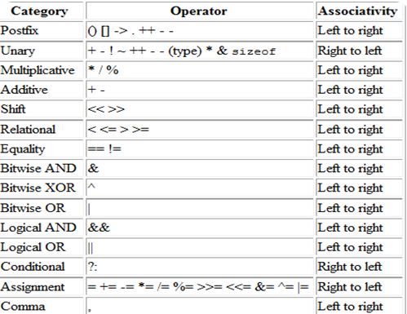
Operator precedence table
Notes:
http://csis.pace.edu/~wolf/CS122/exexpans.html

Slide 33
Infix to Postfix conversion and Postfix expression evaluation
1. infix: (A + B) * C + D / (E + F * G) - H
postfix: A B + C * D E F G * + / + H -
2. infix: A + ((B - C * D) / E ) + F - G / H
postfix: A B C D * - E / + F + G H / -
3. (A * B + C) / D - E / (F + G)
postfix: A B * C + D / E F G + / -
4. What is the value of the following postfix expression?
54 6 + 7 4 - * 9 / 35 15 + +
http://csis.pace.edu/~wolf/CS122/exexpans.html
Notes:
http://csis.pace.edu/~wolf/CS122/exexpans.html

Slide 34
Evaluation of an Infix Expression
STEP 1: Convert the infix expression into its equivalent postfix expression
Algorithm to convert an Infix notation into postfix notation
Step 1: Add ‘)” to the end of the infix expression
Step 2: Push “(“ on to the stack
Step 3: Repeat until each character in the infix notation is scanned
IF a “(“ is encountered, push it on the stack
IF an operand (whether a digit or an alphabet) is encountered,
add it to the postfix expression.
IF a “)” is encountered, then;
. Repeatedly pop from stack and add it to the postfix expression until a “(” is encountered.
b. Discard the “(“. That is, remove the “(“ from stack and do not
add it to the postfix expression
IF an operator X is encountered, then;
Repeatedly pop from stack and add each operator (popped from the stack) to the postfix expression which has the same precedence or a higher precedence than X
b. Push the operator X to the stack
Step 4: Repeatedly pop from the stack and add it to the postfix expression
until the stack is empty
Step 5: EXIT

Slide 35
Evaluation of an Infix Expression
STEP 2: Evaluate the postfix expression
Algorithm to evaluate a postfix expression
Step 1: Add a “)” at the end of the postfix expression
Step 2: Scan every character of the postfix expression and repeat
steps 3 and 4 until “)”is encountered
Step 3: IF an operand is encountered, push it on the stack
IF an operator X is encountered, then
a. pop the top two elements from the stack as A and B
b. Evaluate B X A, where A was the topmost element and B was
the element below A.
c. Push the result of evaluation on the stack
[END OF IF]
Step 4: SET RESULT equal to the topmost element of the stack
Step 5: EXIT

Slide 36
Evaluation of an Infix Expression
Example: evaluate “9 - (( 3 * 4) + 8) / 4”.
Step 1 infix “(9 - (( 3 * 4) + 8) / 4)" => postfix “9 3 4 * 8 + 4 / -“
Step 2 evaluate “9 3 4 * 8 + 4 / -“
infix | Stack | postfix
( | (
9 | ( | 9
- | ( - | 9
( | (-( | 9
( | (-(( | 9
3 | (-(( | 9 3
* | (-((* | 9 3
4 | (-((* | 9 3 4
) | (-( | 9 3 4 *
+ | (-(+ | 9 3 4 *
8 | (-(+ | 9 3 4 * 8
) | (- | 9 3 4 * 8 +
/ | (-/ | 9 3 4 * 8 +
4 | (-/ | 9 3 4 * 8 + 4
) |  | 9 3 4 * 8 + 4 / -
Character scanned | Stack
9 | 9
3 | 9, 3
4 | 9, 3, 4
* | 9, 12
8 | 9, 12, 8
+ | 9, 20
4 | 9, 20, 4
/ | 9, 5
- | 4

Slide 37
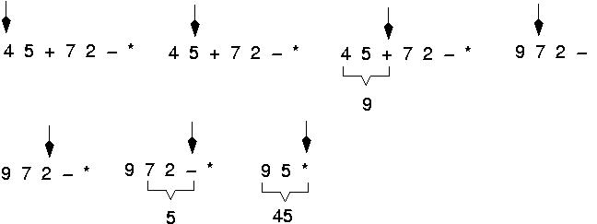
Example: postfix expressions (cont.)

Slide 38
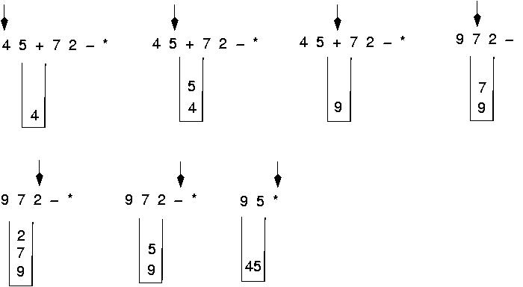
Postfix expressions: Algorithm using stacks (cont.)

Slide 39
Convert Infix Expression into Prefix Expression
Consider an infix expression: (A – B / C) * (A / K – L)
Step 1: Reverse the infix string. Note that while reversing the string you must interchange left and right parenthesis.
(L – K / A) * (C / B – A)
Step 2: Obtain the corresponding postfix expression of the infix expression obtained as a result of Step 1.
The expression is: (L – K / A) * (C / B – A)
Therefore, [L – (K A /)] * [ (C B /) - A ]
= [LKA/-] * [ CB/A-]
= L K A / - C B / A - *
Step 3: Reverse the postfix expression to get the prefix expression
Therefore, the prefix expression is * - A / B C - / A K L

Slide 40
Infix to Prefix
A*B+ C/D
Prefix: +*AB/CD
(A*B)+C
Prefix: +*ABC

Slide 41
(A && B) || C || ! (E > F)
Prefix: || && A B || C ! > E F
Postfix: A B && C || E F > ! ||
! (A && ! ((B < C) || (C > D))) || (C < E)
postfix: A B C < C D > || ! && ! C E < ||
prefix: || ! && A ! || < B C > C D < C E

Slide 42
https://www.geeksforgeeks.org/data-structure-gq/top-mcqs-on-stack-data-strcuture-with-answers/
Previous years GATE questions
https://questions.examside.com/past-years/gate/question/pconsider-the-queues-qsub1sub-containing-four-element-gate-cse-theory-of-computation-finite-automata-and-regular-language-sozflytewkqwhc7j
Practice MCQ questions

Slide 43
Lab Experiments
1) Implement all stack operations using array and linked list: Push, Pop, Display.
2) Reverse string using stack
3) Convert infix to postfix expression using stack and array
4) Evaluate postfix expression using stack and array.

